Slide 1
Anime Data A portfolio project -Yogaraj Kori
0899803533
yogarajkori@gmail.com​
https://www.kaggle.com/yogarajkori
https://github.com/yogaraj-kori

Slide 2
Agenda
Introduction
Why Anime Data
Python Project- posted on Kaggle
ETL transformations
Visual aids- PowerBI
Final takeaways

Slide 3

Introduction

Slide 4
As a person who loves Anime, This was a curious project for me as I want to understand why such an interesting niche does not have a proper audience.
With this project, I want to promote the growing interest in Anime and along with that my own technical skills as a Data Analyst. One of the Key factors we are solving is the Minimalist Complexity Problem.
Every company has a different way to approach a problem along with utilizing different tools for their solutions, and as such I have implemented this in 2 different approaches.
Everything in Python- I have performed cleaning and analysis in python and have posted in Kaggle(Link provided below). https://www.kaggle.com/code/yogarajkori/anime-data-analysis
Transformations in Alteryx ETL tool and Visualisations in PowerBI: Here I perform the same analysis as in python but with different visualisations.

Slide 5

Python Implementation

Slide 6
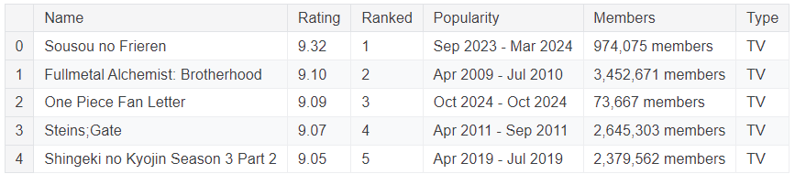
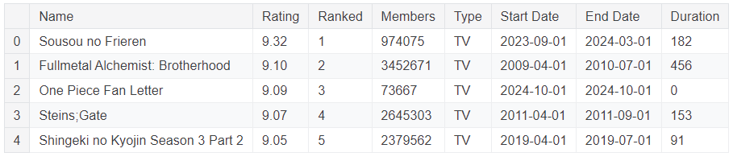
Let us look at the dataset which we have and understand the data.
As we can see we have a minimalist dataset, and our job is to get the most out of the data. Some transformations include removing “members” text from Members feature, Separating the start and end date from popularity and creating new features which will be required for analysis. Here is the look at the final transformed results.

Slide 7
Analysis

Slide 8
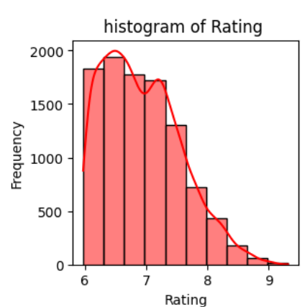
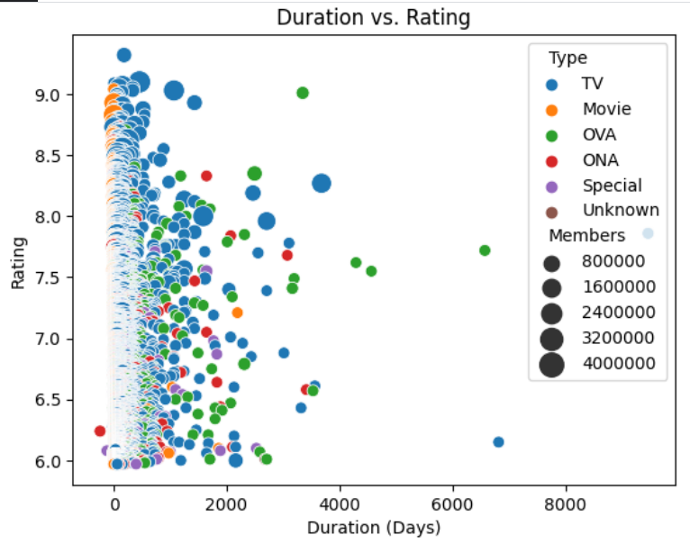
Understanding the changes in rating. We see that most series are rated between 6 to 7 (average rating) And very few ratings are at 9. Now let us look at what affects this ratings.
2.Does the Length of Anime affect its rating.
The bigger circles indicate that it had more members. We can see that most of the higher rated anime were played on TV or as a movie and had members between 1600000 to 3200000. This indicates that the high rated anime does not necessarily mean that it has more members. Along with this, if we also look at duration, we can see that most popular anime are short and sweett :p

Slide 9
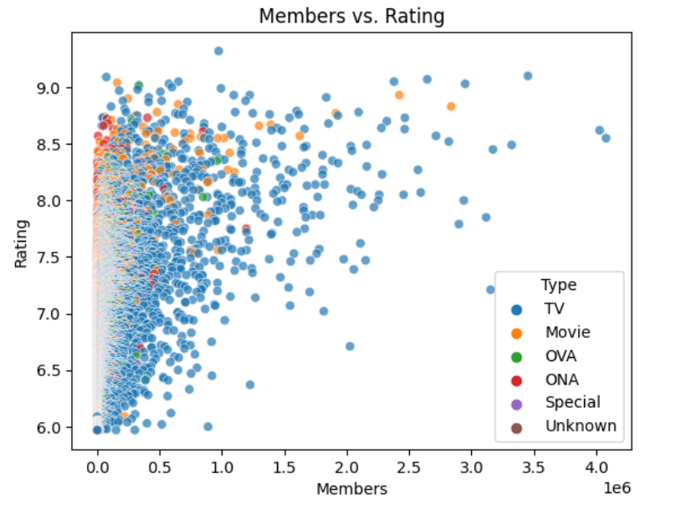
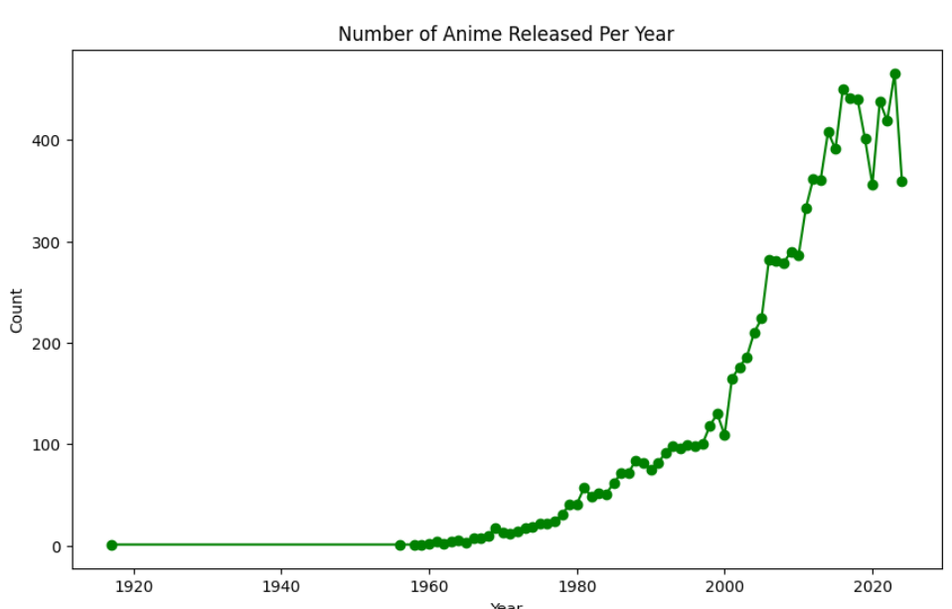
3. Are High Rated Anime Popular? This plot confirms the findings from above plot saying that high rated anime does not necessarily mean it is more popular
4.Is this popularity Encouraging production?
The bigger circles indicate that it had more members. We can see that most of the higher rated anime were played on TV or as a movie and had members between 1600000 to 3200000. This indicates that the high rated anime does not necessarily mean that it has more members. Along with this, if we also look at duration, we can see that most popular anime are short and sweett :p

Slide 10
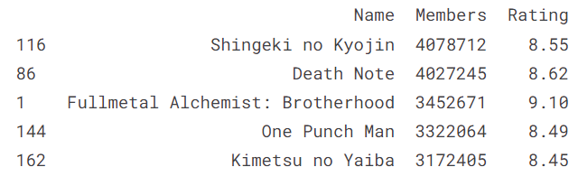
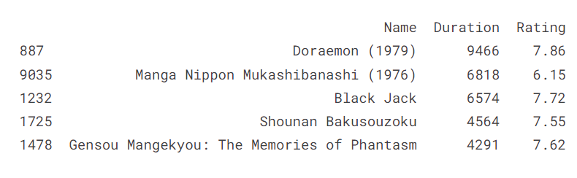
5. Most Popular Anime with highest viewership
6. Longest Running Anime

Slide 11
ETL

Slide 12
why Alteryx?
Speedy Transformations
Simplicity: easy to understand.
Scalability: Higher volumes of data does not affect our job.
Free for me: Alteryx has a free tool for students.
Easy Setup: Its clearly easy to setup Alteryx with no additional files.
A good way to impress you guys: No explanation needed I believe.

Slide 13
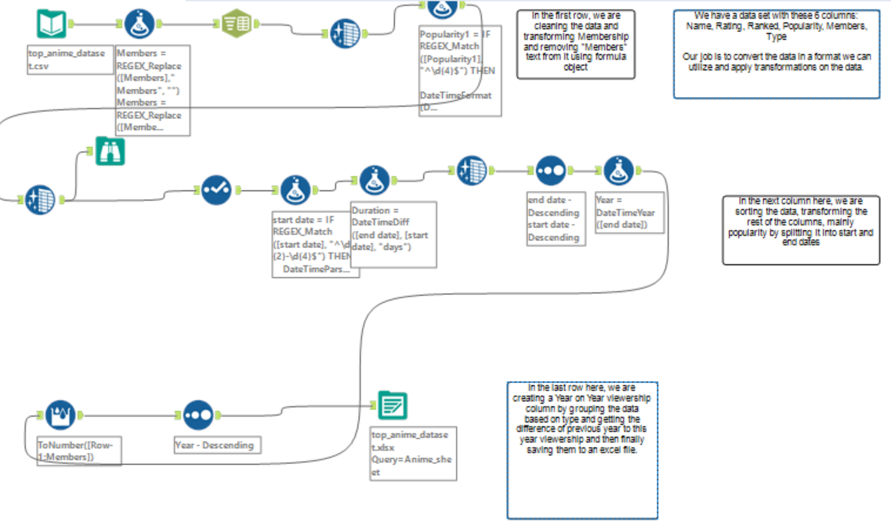
Workflow​
Transformations 1. Removed “members” from Members Feature.
2. Cleaned Null values and empty values. 3. Split Popularity column into start date and end date.
4. Changed data types. 5. Added duration column as difference of start and end date 6. calculated Year on Year column by grouping Years of the anime and performing calculation like YOY=Members-{Year-1}Members

Slide 14

POwerBi
PowerBI is a powerful tool for visualizations and dashboarding
Added point for using PowerBi is it is free

Slide 15
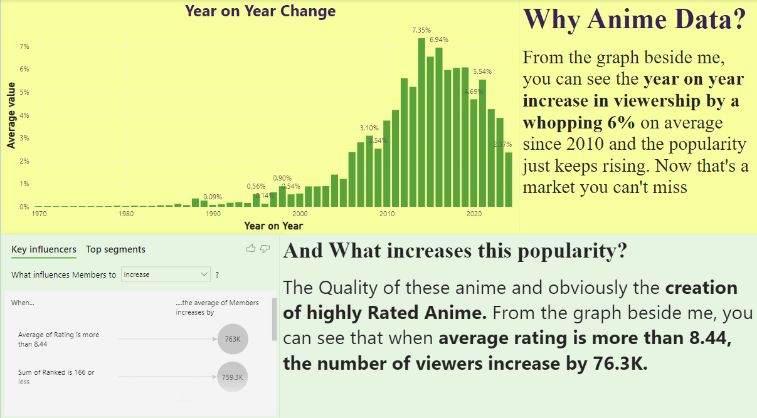
Visualization 1

Slide 16
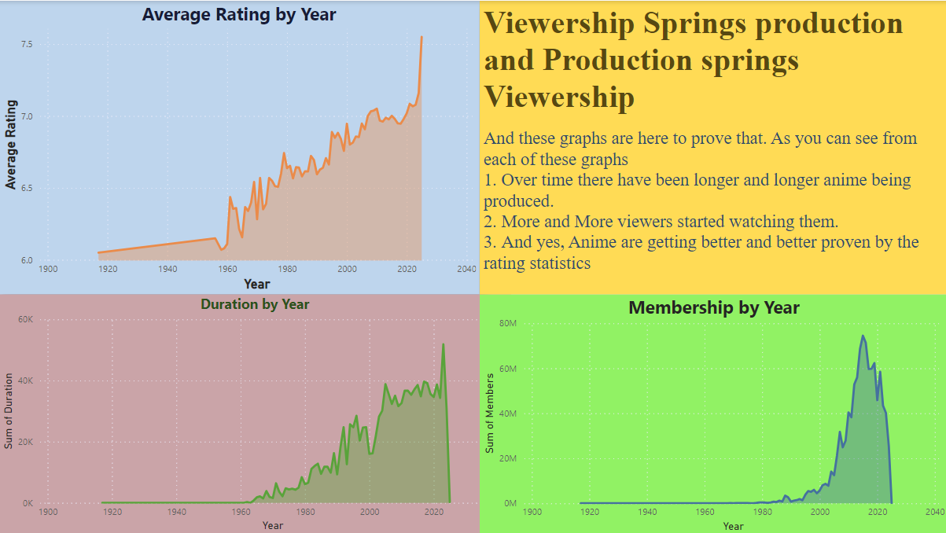
Visualization 2

Slide 17
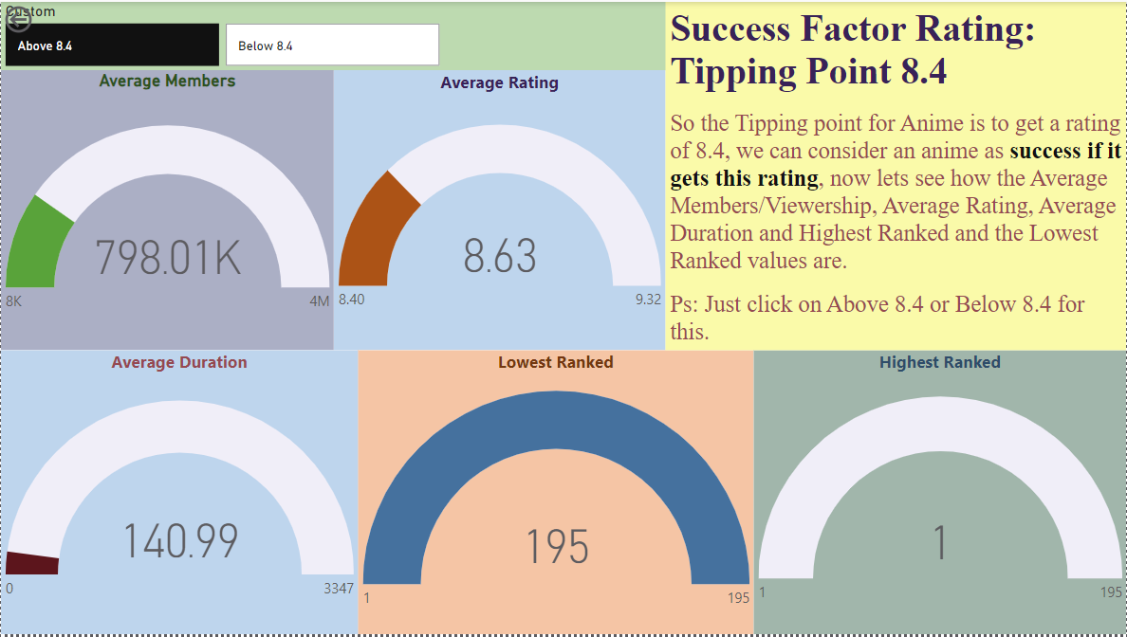
Visualization 3

Slide 18
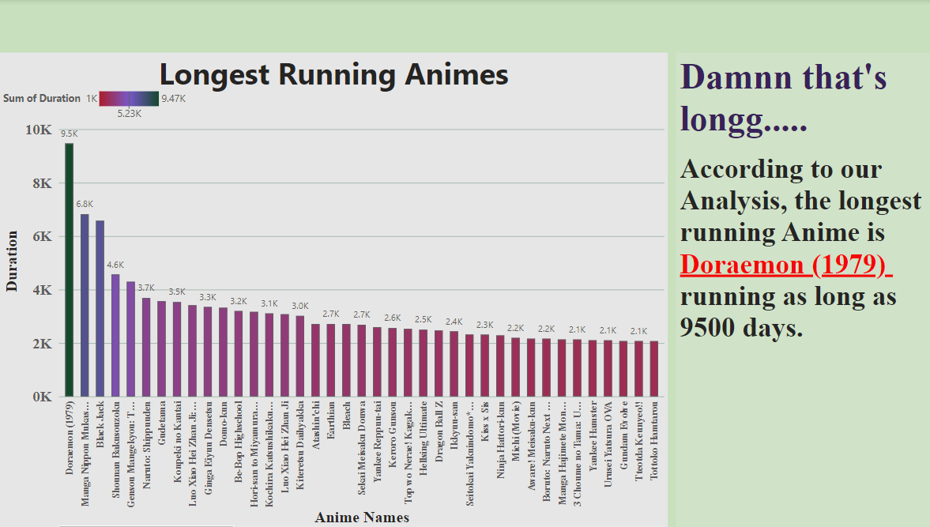
Visualization 4

Slide 19
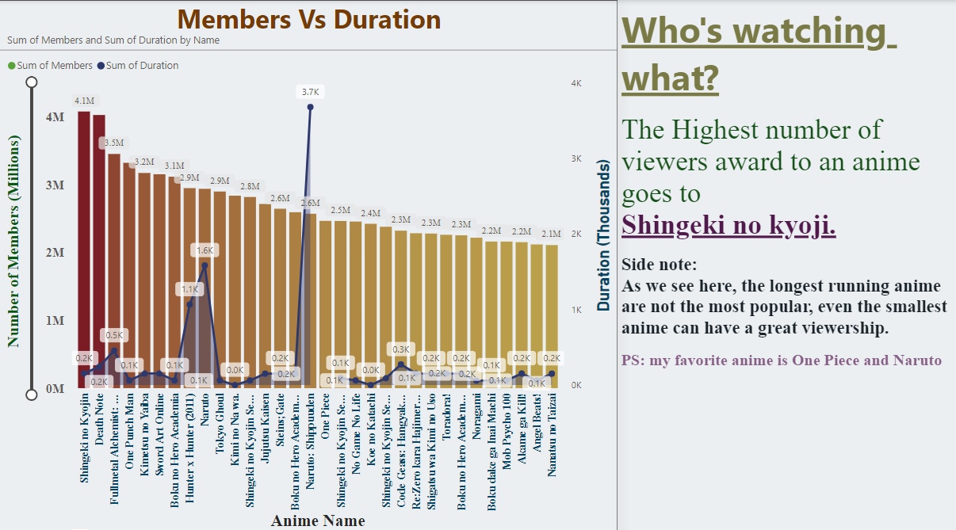
Visualization 5

Slide 20
Analysis Results
The average Rating right now is at 6.5, but the tipping factor is 8.4 so we need better anime with better production.
High Rated Anime does not necessary mean that it has high viewership.
Make the Anime short and sweet.
Viewership keeps increasing and there is a shortage in supply and now is the right time for a new and exciting anime.
While the longest running anime has a fanbase you can not grab, shorter anime like Shingeki no Kyoji are duplicable and since it’s shorter, it is budget friendly.

Slide 21
Personal Conclusion
Anime are great, please do watch it and promote it.
If you have a suggested anime, please do let me know here: yogarajkori@gmail.com
Also, I am looking for a job as a data analyst, if there is an opening in Ireland, help me out please.

Slide 22
Future work
SQL server: while PowerBI and Alteryx are powerful, if I had access to a free SQL server the overall execution time for this project would be lower.
Live data: If you had access to Live anime data, we could make this a continuous Dashboard making it a Reliable and Live dashboards.
Homogenous Data Integration: If we had access to more similar dataset, it would help us draw more conclusion from our analysis.

Slide 23
THANK YOU
Yogaraj Kori
0899803533
yogarajkori@gmail.com​
https://www.kaggle.com/yogarajkori
https://github.com/yogaraj-kori

